Slide 1



Markov decision process (MDP)

Slide 2
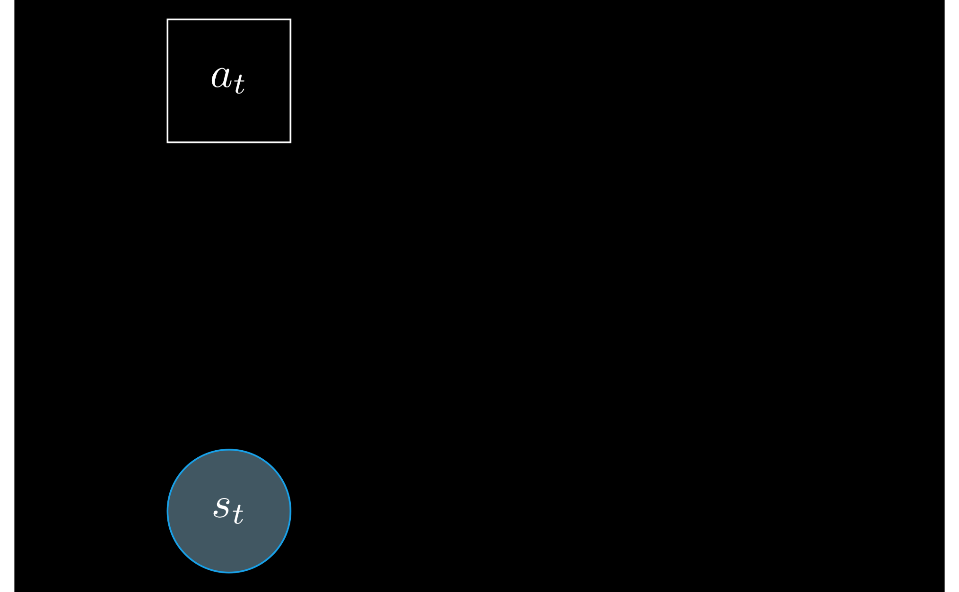
Markov decision process (MDP)

Slide 3
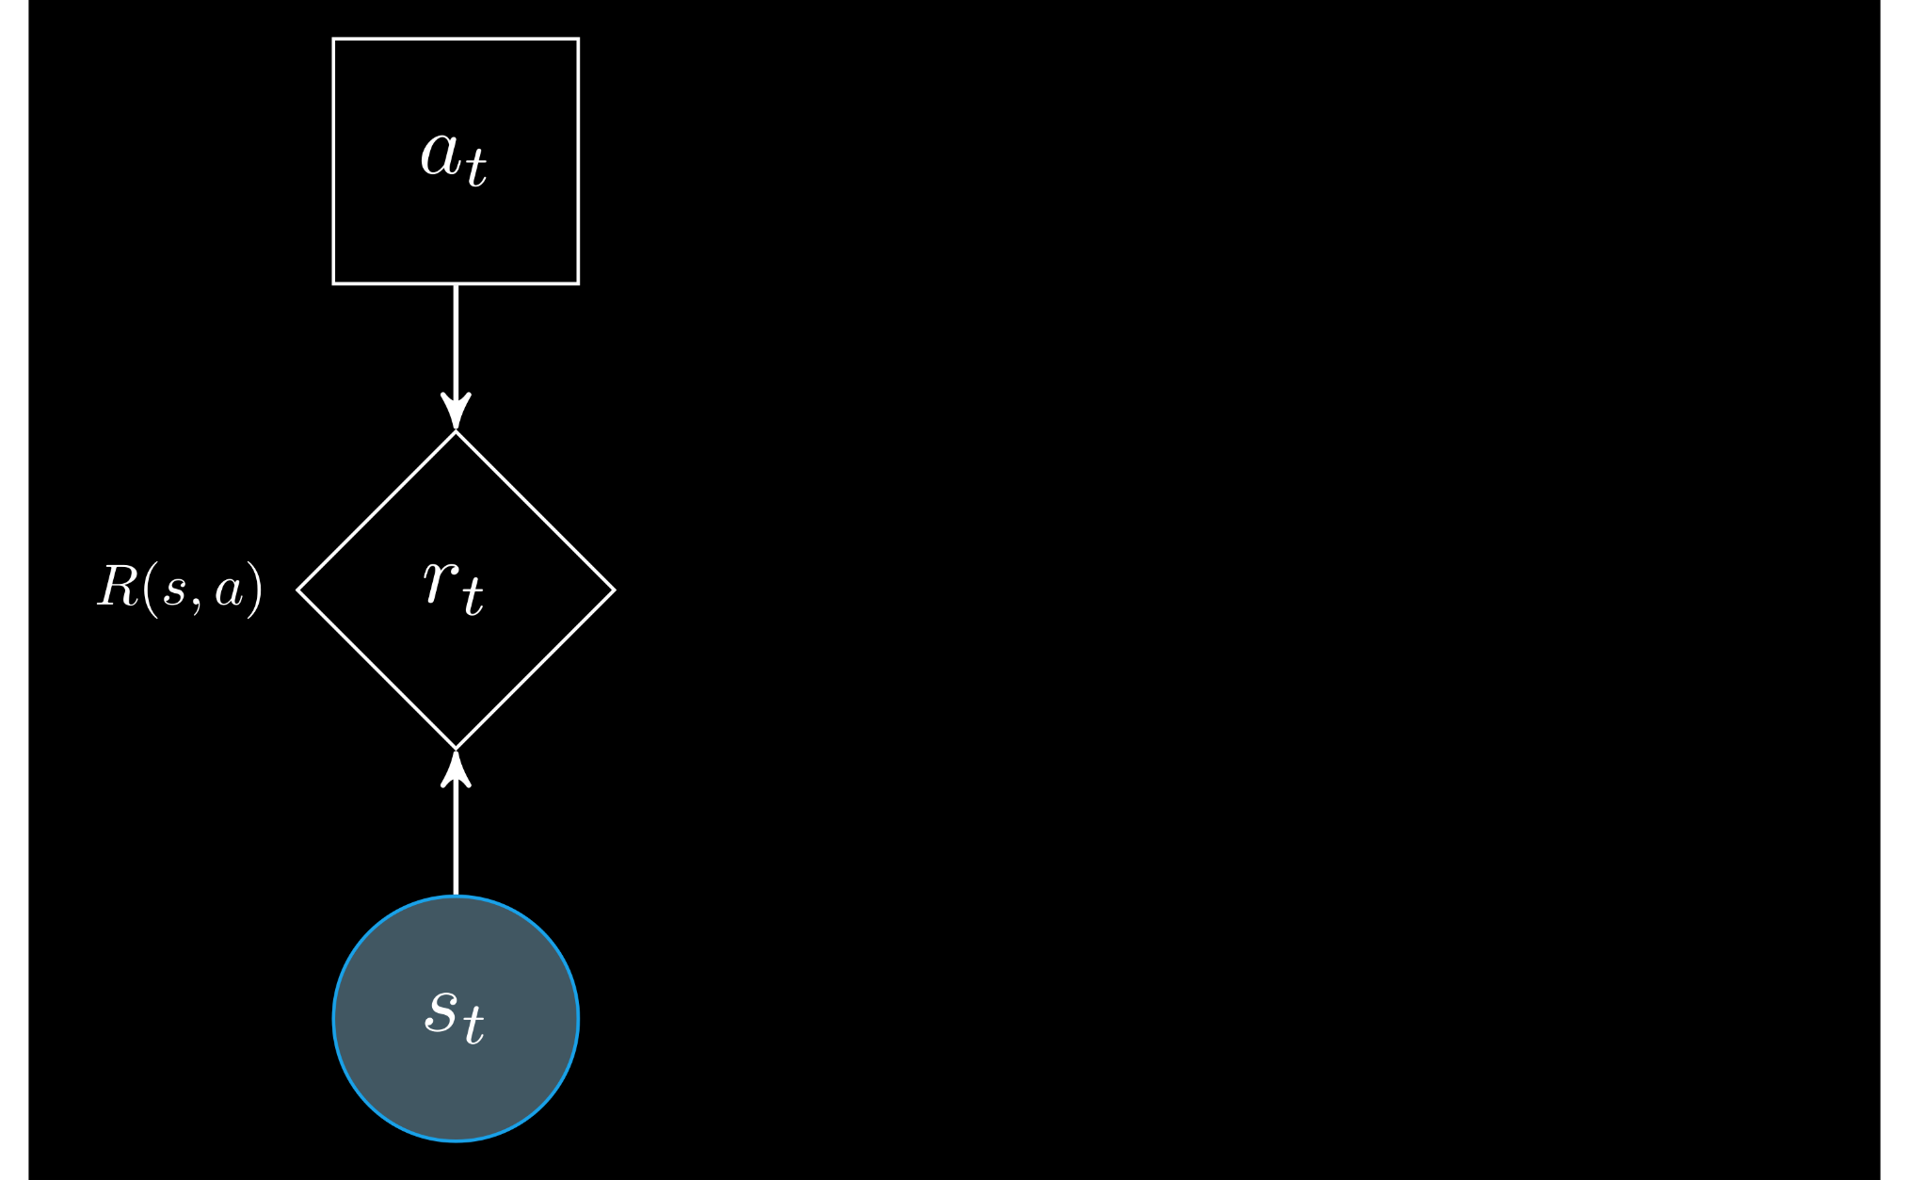
Markov decision process (MDP)

Slide 4
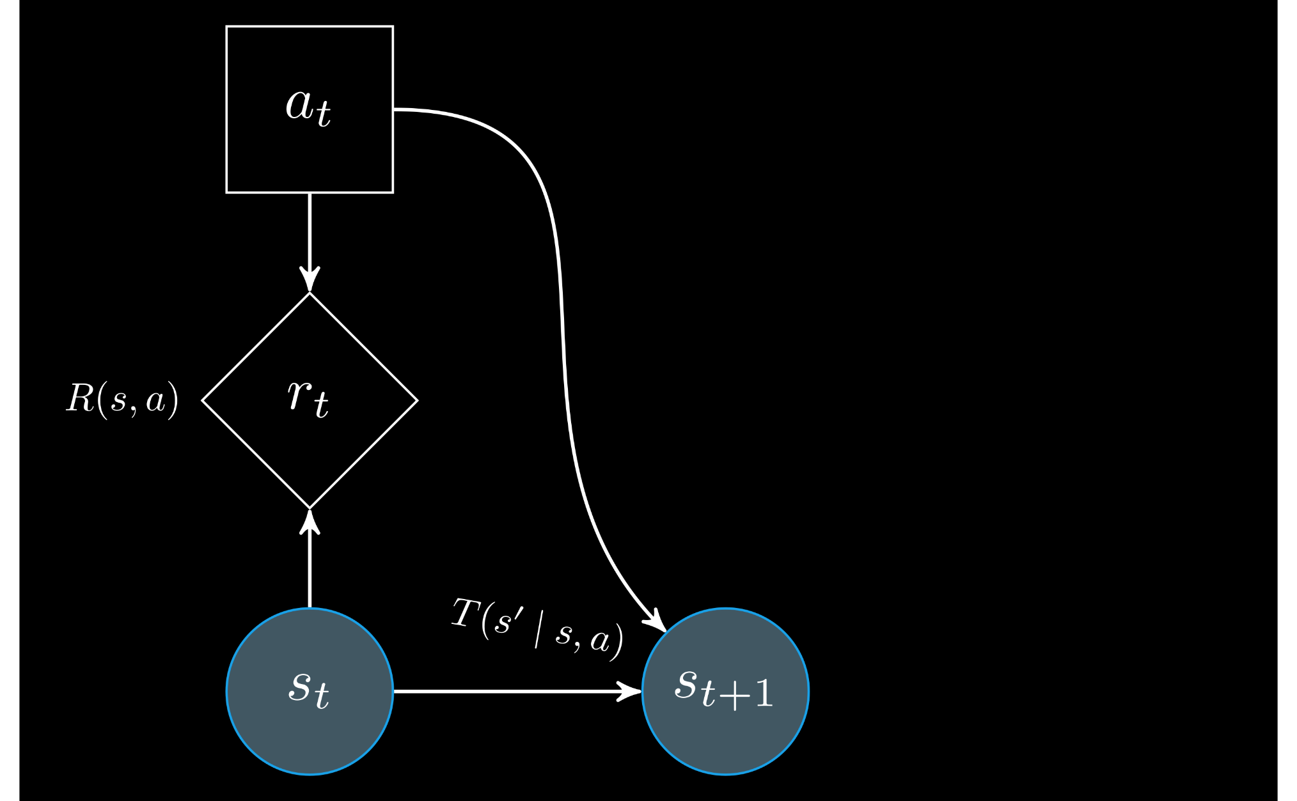
Markov decision process (MDP)

Slide 5
Markov decision process (MDP)

Slide 6

Markov decision process (MDP)

Slide 7

Markov decision process (MDP)

Slide 8
Real-world problem: True states are unobservable!

Slide 9

Real-world problem: True states are unobservable!

Slide 10

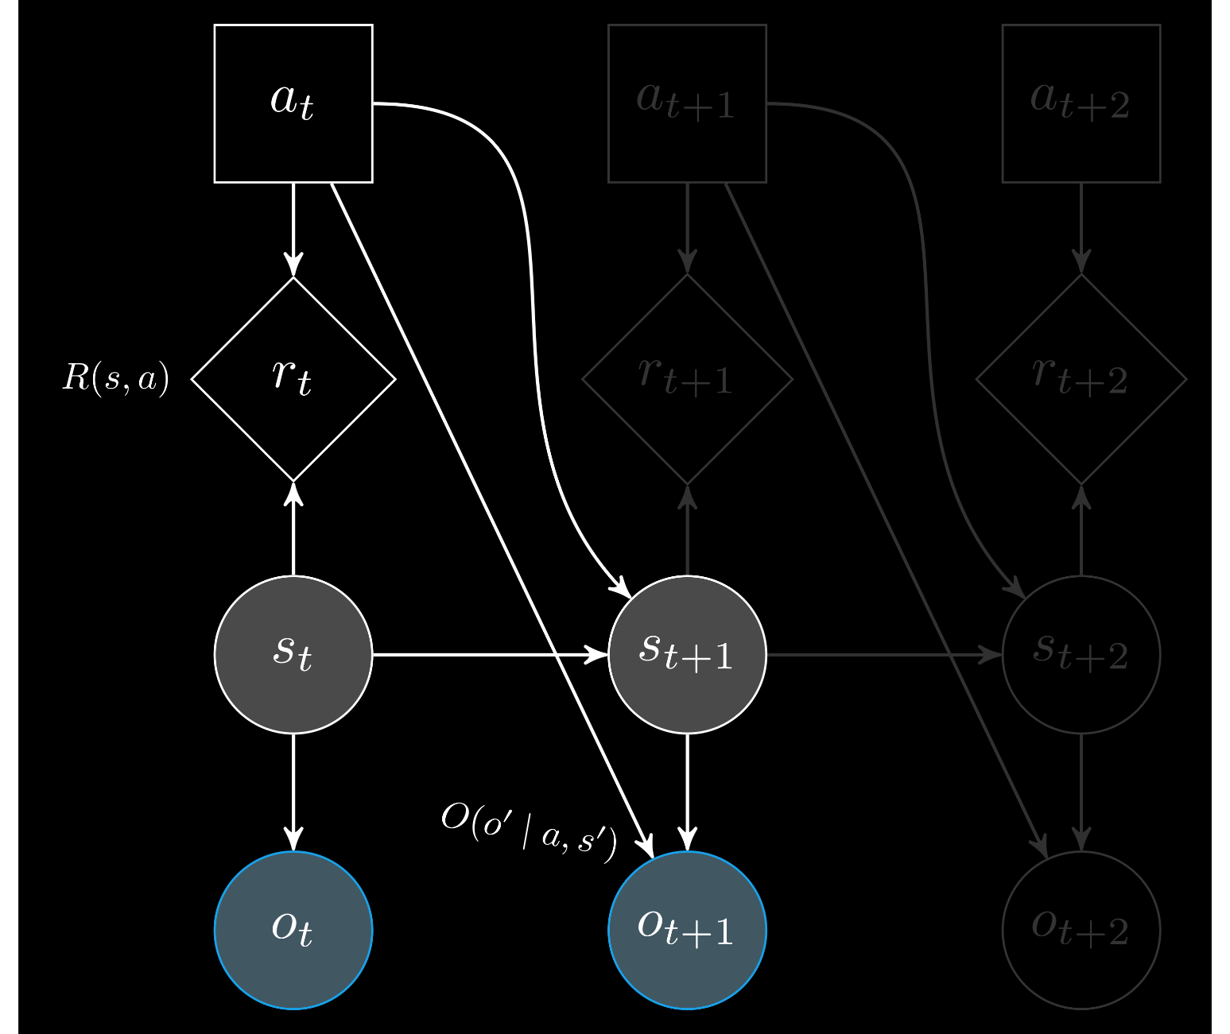
Partially observable Markov decision process (POMDP)

Slide 11


State uncertainty: Beliefs

Slide 12


State uncertainty: Beliefs

Slide 13
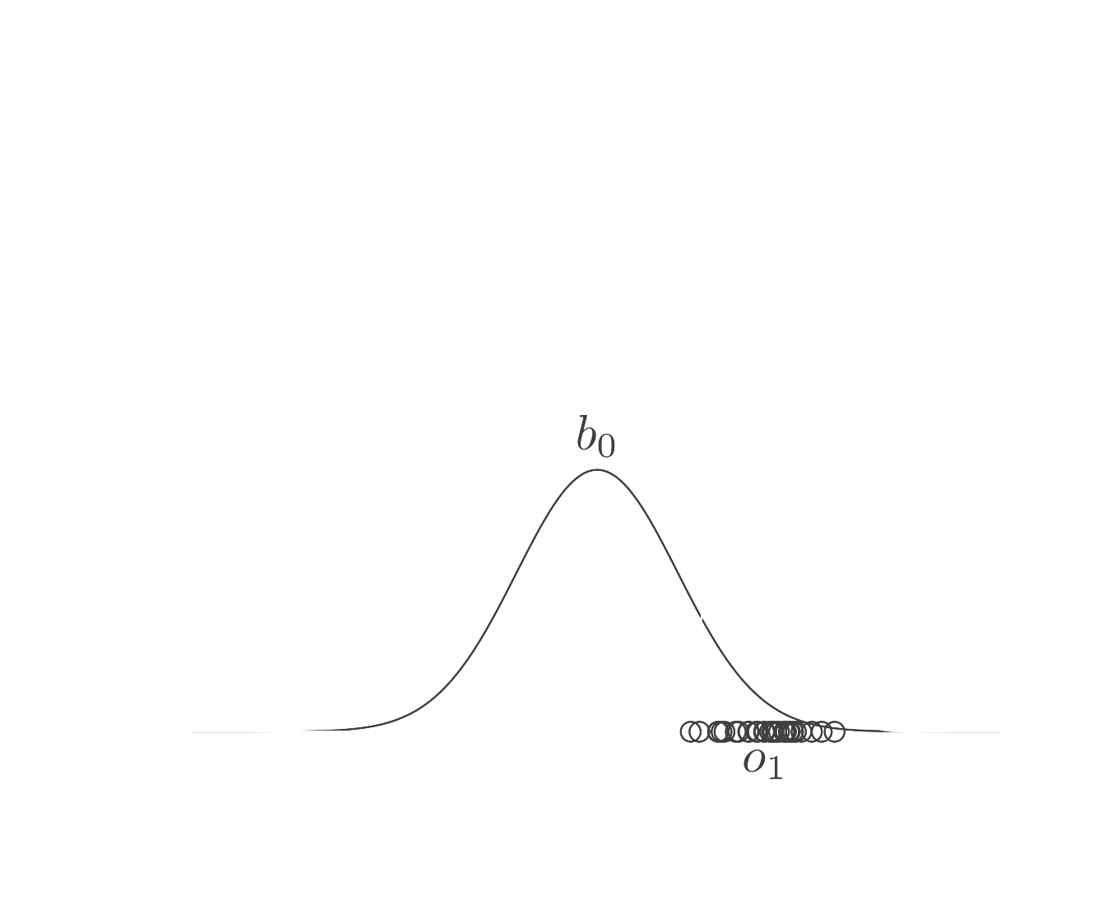
State uncertainty: Beliefs

Slide 14

A policy π maps beliefs to actions
a = π(b)
Solution: Find a policy
Goal: Take the best action from a given belief

Slide 15
Solution: Find a policy
A policy π maps beliefs to actions
a = π(b)

Slide 16

Objective: Maximize rewards
Find an action that maximizes reward

Slide 17
Objective: Maximize rewards
Find a policy that maximizes reward

Slide 18
Objective: Maximize rewards
Find a policy that maximizes reward

Slide 19
Objective: Maximize rewards
Find a policy that maximizes discounted reward

Slide 20
Objective: Maximize rewards
Find a policy that maximizes discounted future reward

Slide 21
Objective: Maximize rewards
Find a policy that maximizes expected discounted future reward

Slide 22
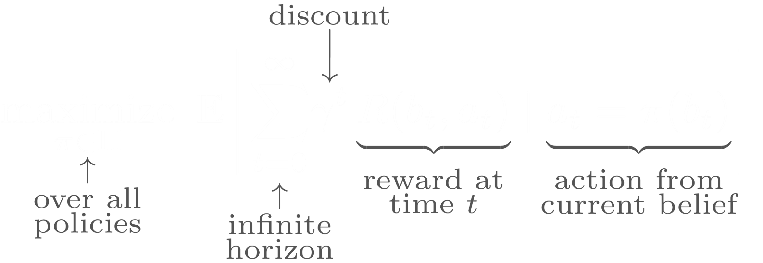
Objective: Maximize rewards
Find a policy that maximizes expected discounted future reward

Slide 23

Solution algorithms
Find the optimal policy π
that maps beliefs to actions

